Slide 1
Getting Started: PART II
For any questions, email Greg at gihanson@wisc.edu

Slide 2
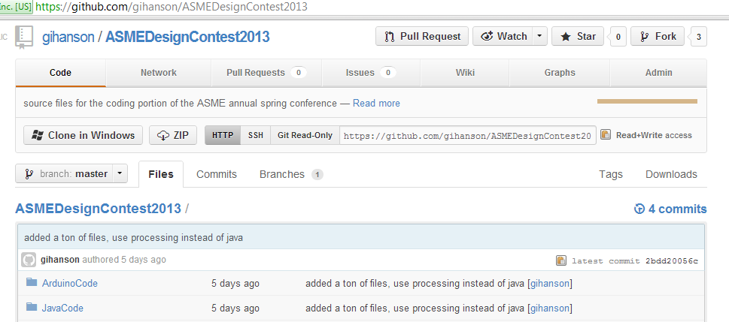
Get The Latest Code
Go to https://github.com/gihanson/ASMEDesignContest2013 and get the latest code.
If you want to use Github – please follow the steps from the first Getting Started Tutorial for setting up an account, downloading the UI, or how to clone a repo – if not, you can just download the zip

Slide 3
No More Eclipse/Java
The code for the design competition has moved from Java (Language) in Eclipse (Environment) to Processing in Processing Sketchbook
The Processing coding language is very similar to Java so syntax for variable declaration, if/while/for’s, etc are almost exactly the same
To open the Processing Sketchbook, go to \ASMEDesignContest2013\processing-2.0b6-32 and click on Processing.exe extension
Note that we are using the 32-bit version since some functionality is only available in this mode vs the 64-bit version
To view out current code, go to File->Open, and browse to \ASMEDesignContest2013\Processing\BeginnerProcessing_Arduino and select the .pde file

Slide 4
Want to Play With a 360 Controller? Part I
Processing has a library called proControll which allows you to use controllers in your program.
For a full list of the proControll API, check out http://creativecomputing.cc/p5libs/procontroll/
Our code can be configured for use in Mac and Windows
Simply change the “usingController” integer near the top of the file to either 1 or 2
To install the necessary software for connecting your 360 controller to your PC via USB please use the download links below:
Windows: http://www.microsoft.com/hardware/en-us/p/xbox-360-controller-for-windows#support
Mac: http://tattiebogle.net/index.php/ProjectRoot/Xbox360Controller/OsxDriver
Linux: Installation will vary based on version – Google is your friend

Slide 5
Want to Play With a 360 Controller? Part II
If you have installed the software, you can now plug in your 360 controller and then in Processing Sketchbook, go to File->Run to begin execution of the BeginnerProcessing_Arduino.pde
The program should output which buttons (A B Y X) you have pressed, recognize Dpad button pushes, and left/right joystick movements
On Windows, the left and right bumpers and pushing in on the joysticks have been configured to do this as well
Windows and Mac have different button mappings – meaning pressing A would not have the same result as it would on a Mac, so each feature needs to be handled according to OS type

Slide 6
Processing and the Arduino
Processing has a library which allows for direct communication with an Arduino via serial (USB) connection.
There is a tutorial for setting everything up here: http://www.arduino.cc/playground/interfacing/processing
NOTE: the files from Github already have everything downloaded and installed everywhere they need to be
The provided code in BeginnerProcessing_Arduino.pde has some sample code in the setup() function
Basically if this was the code in the Arduino Sketchbook: pinMode(2, OUTPUT); This is how it will look in Processing: arduino.pinMode(2, Arduino.OUTPUT);

